Slide 1

Intelligent Video Anonymization: Face Detection, Recognition, and Blurring
SHIREEN ALIZA ALI 22BAI1095

Slide 2




Table of contents
01
02
03
04
05
06
Introduction & Problem Statement
Literature Reviews
Base Paper & LIterature Gaps
Proposed Architecture
Module Description & Results
References

Slide 3



Problem Statement
Project Scope
With the increasing use of video surveillance and the proliferation of video content online, protecting the privacy of individuals captured in these videos has become a concern.
Traditional methods of anonymization are often manual, time-consuming, and prone to errors, making them insufficient for large-scale or real-time applications.
This project aims to develop a generic and customizable system for video anonymization that automatically detects, recognizes, and blurs specific faces in videos.
The system will be designed to handle various use cases, including public surveillance, media publishing, and healthcare video recording.

Slide 4
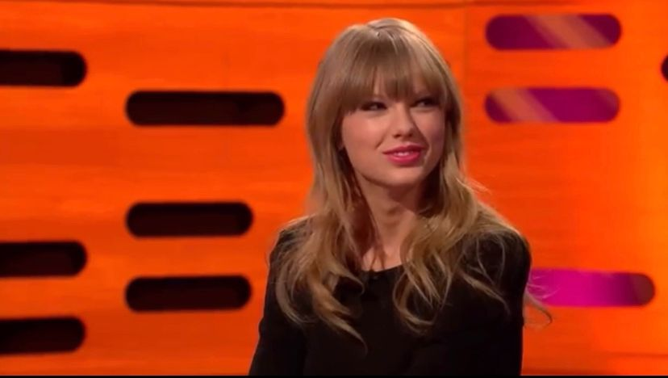
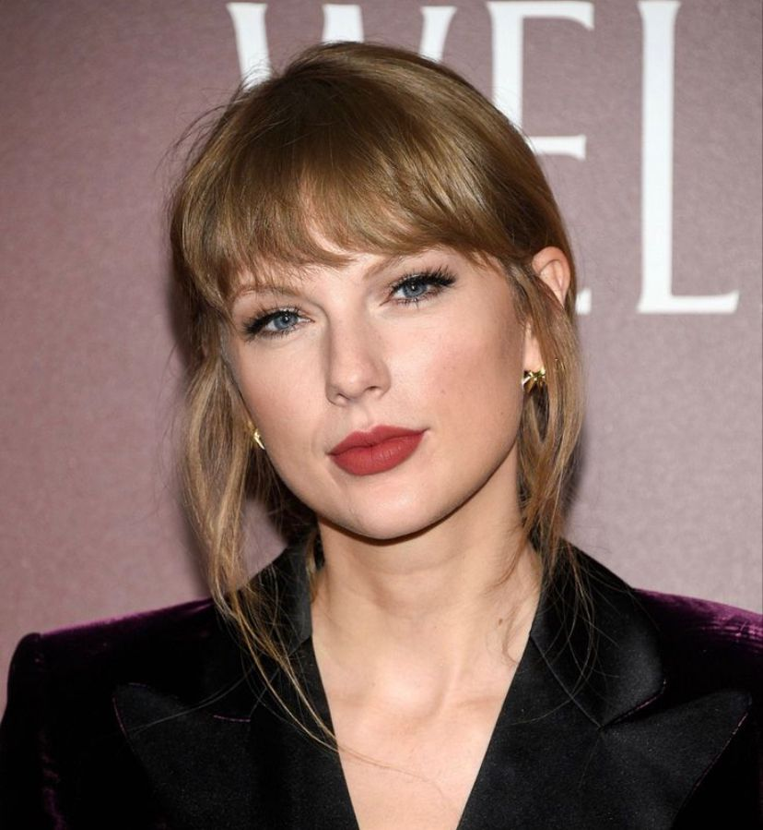

Introduction
The system takes as input a video file containing multiple individuals and a reference image of the face to be anonymized.
The video is processed frame by frame, where faces are detected using MTCNN, and the detected faces are compared with the reference image using FaceNet embeddings.
If a match is found, the corresponding face in the frame is blurred using a Gaussian blur technique.
The output is a processed video file in which only the specified face has been anonymized while leaving all other faces intact, ensuring privacy while preserving the overall context of the video.
Fig 01. Input Reference Image
Fig 02. Sample output frame

Slide 5
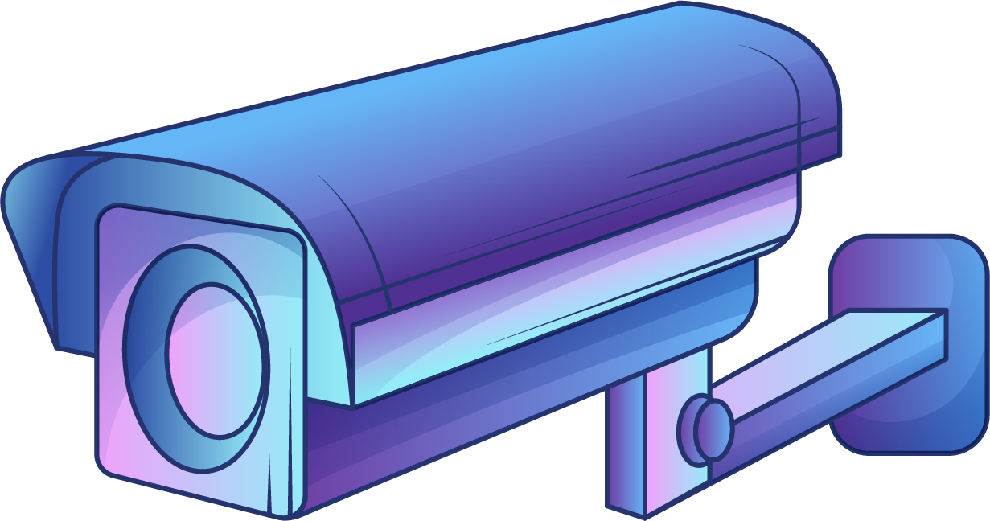
Literature Reviews & Existing Methods
The field of video anonymization has evolved significantly over the years, with various approaches being proposed to tackle the challenge of privacy protection.
Traditional methods include manual editing, where faces are blurred or masked frame by frame, which is labor-intensive and inefficient.
Techniques such as Haar Cascades, HOG + SVM, and more recently, Convolutional Neural Networks (CNNs) have been employed for face detection, while models like FaceNet and DeepFace have shown remarkable accuracy in face recognition.
Existing video anonymization methods typically fall into two categories: manual editing and automated systems. Manual methods are highly accurate but are time-consuming and not scalable for large datasets or real-time processing. Moreover, many automated systems do not allow for selective anonymization, where only specific faces are blurred, leading to over-censorship or under-censorship.

Slide 6

Base Paper & Research Gaps
Yang, K., Yau, J.H., Fei-Fei, L., Deng, J. &amp; Russakovsky, O.. (2022). A Study of Face Obfuscation in ImageNet. <i>Proceedings of the 39th International Conference on Machine Learning</i>, in <i>Proceedings of Machine Learning Research</i> 162:25313-25330 Available from https://proceedings.mlr.press/v162/yang22q.html.
https://proceedings.mlr.press/v162/yang22q.html
This paper investigates the impact of face obfuscation techniques, such as blurring and mosaicing, on visual recognition tasks, specifically within the ImageNet challenge benchmark. The researchers first annotate faces in the dataset and then evaluate how obfuscating these faces affects the performance of deep neural networks on recognition tasks. They find that face obfuscation leads to only a minimal drop in recognition accuracy (≤ 1.0%). Additionally, the study shows that features learned on obfuscated images transfer effectively to various downstream tasks, including object recognition, scene recognition, face attribute classification, and object detection. The findings highlight the potential for privacy-preserving visual recognition and propose improvements for future visual datasets.

Slide 7
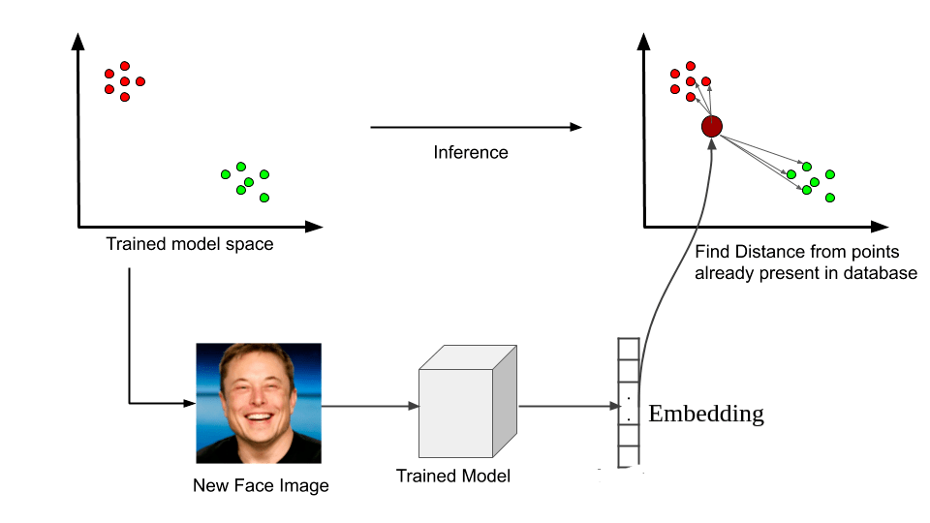
Propose Architecture
The proposed solution is a comprehensive and intelligent video anonymization system that integrates face detection, recognition, and blurring techniques.
The system will utilize a deep learning-based approach, combining MTCNN (Multi-task Cascaded Convolutional Networks) for real-time face detection and FaceNet for accurate face recognition.
The blurring process will be customizable, allowing users to select specific faces for anonymization based on pre-uploaded images or other criteria.
The system will be designed for scalability, enabling real-time processing of video streams, and will be adaptable to different application domains through configurable settings.
Fig. 01 Concept of Embeddings

Slide 8
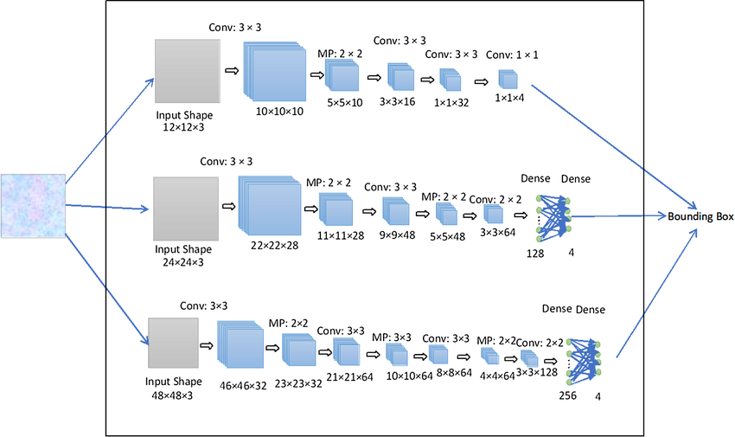
Fig. 02 MTCNN (Multi-task Cascaded Convolutional Networks) architecture

Slide 9

Modules
1
2
3
4
Input Module
Handles the ingestion of video files or streams.
Preprocessing Module
Involves tasks like resizing, frame extraction, and basic image enhancements
Face Detection Module
Utilizes a deep learning model to detect faces in each frame.
Face Recognition Module
Employs a model like FaceNet to match detected faces with a predefined database of faces.
5
6
Blurring Module
Applies Gaussian blur or pixelation to the identified faces that need to be anonymized.
Output Module
Reassembles the video with anonymized frames and outputs the final video file.

Slide 10
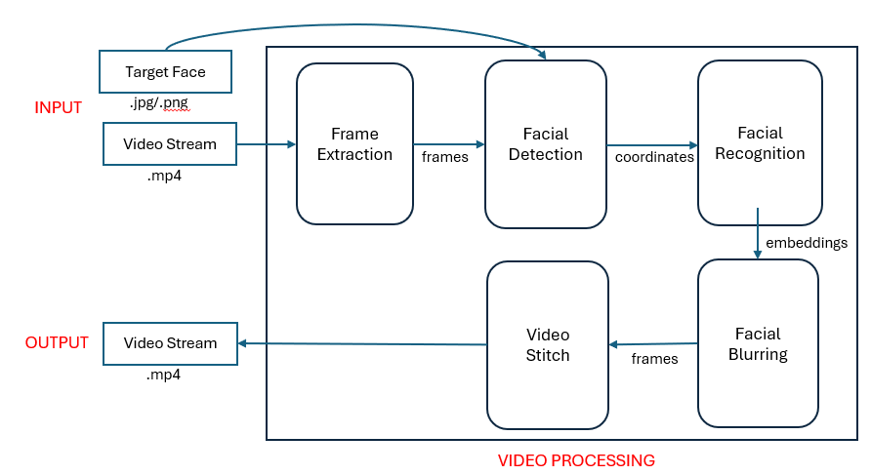
Architecture Diagram

Slide 11

Detailed Description
Input Module
Preprocessing Module
The Input Module is responsible for ingesting video files or streams into the system.
This module supports various video formats and resolutions, ensuring flexibility and broad applicability.
It includes mechanisms for handling both offline videos and live streams
.
The module also provides an interface for users to upload videos and select specific parameters for processing, such as frame rate and resolution settings.
The Preprocessing Module prepares the video data for subsequent stages of the pipeline.
Key tasks include resizing frames to a consistent resolution, extracting individual frames from the video, and applying basic image enhancement techniques to improve detection accuracy.
This module is crucial for optimizing the performance of the detection and recognition algorithms, ensuring that they operate efficiently regardless of the input video's quality or format.

Slide 12
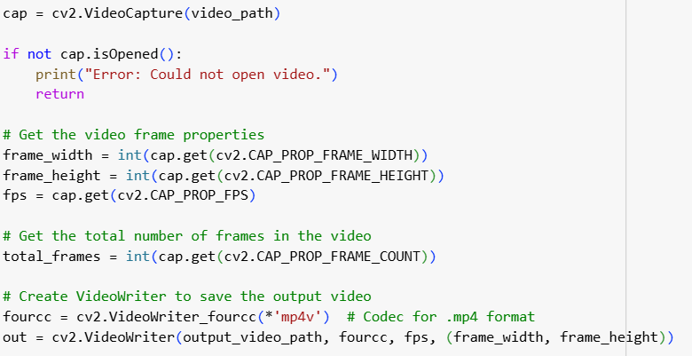
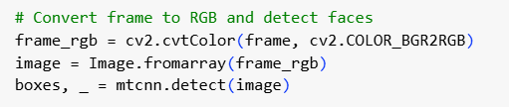

Frame Extraction and Video Processing Module
OpenCV for video processing
OpenCV is a powerful library that allows easy access to video frames, along with capabilities to modify and save frames to a new video.
.

Slide 13
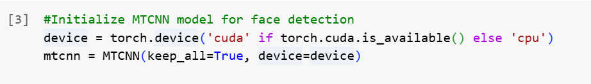
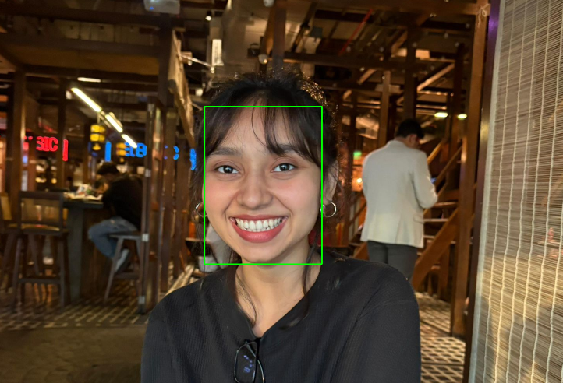
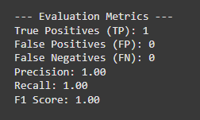
Face Detection Module (MTCNN)
Architecture: MTCNN (Multi-task Cascaded Convolutional Networks).
It is highly efficient in localizing faces in images of varying sizes, scales, and angles. It works well even in real-time video processing.
Fig 03. Bounding Box on Reference Image
Fig 04. Performance Metrics

Slide 14
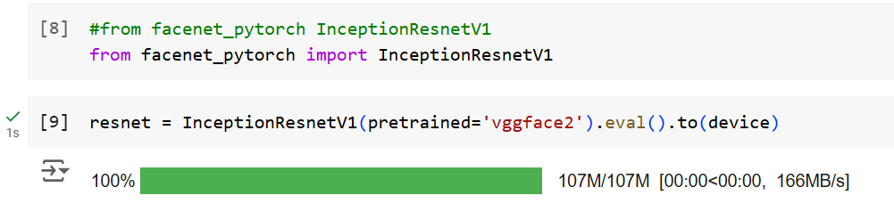
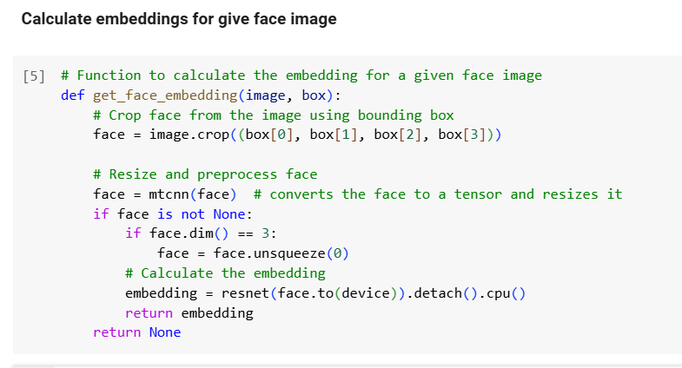
Face Recognition Module
Architecture: Facenet model (based on Inception Resnet v1).
FaceNet is used for creating an embedding for each detected face. By computing embeddings, we can later compare them using distance metrics (e.g., Euclidean distance) to match faces across frames or with a reference face.
.

Slide 15
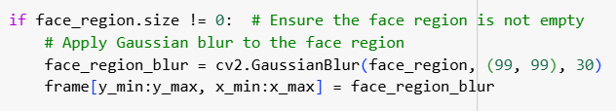
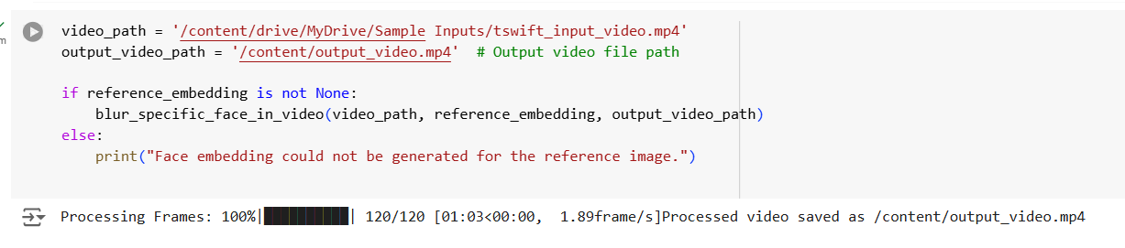
Face Blurring Module
Technique Used: Gaussian Blur.
Gaussian blur is applied to the face region to anonymize it. The blur smooths the pixel values of the face area, making it unrecognizable.
.

Slide 16
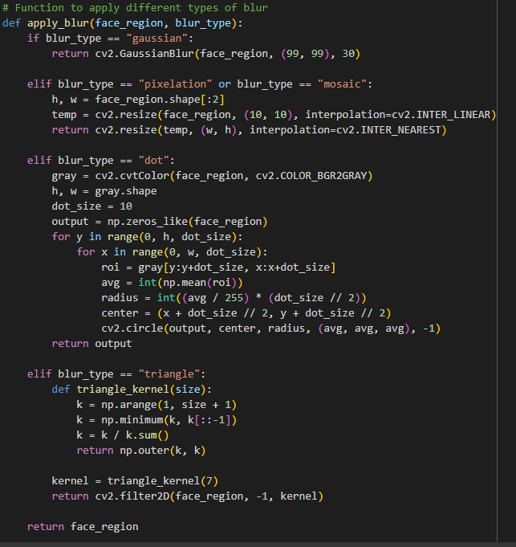
Face Blurring Module
Technique Used: Mosaic(Pixelation), Dot and Triangle Blur.
Custom cv2 blurs
.

Slide 17
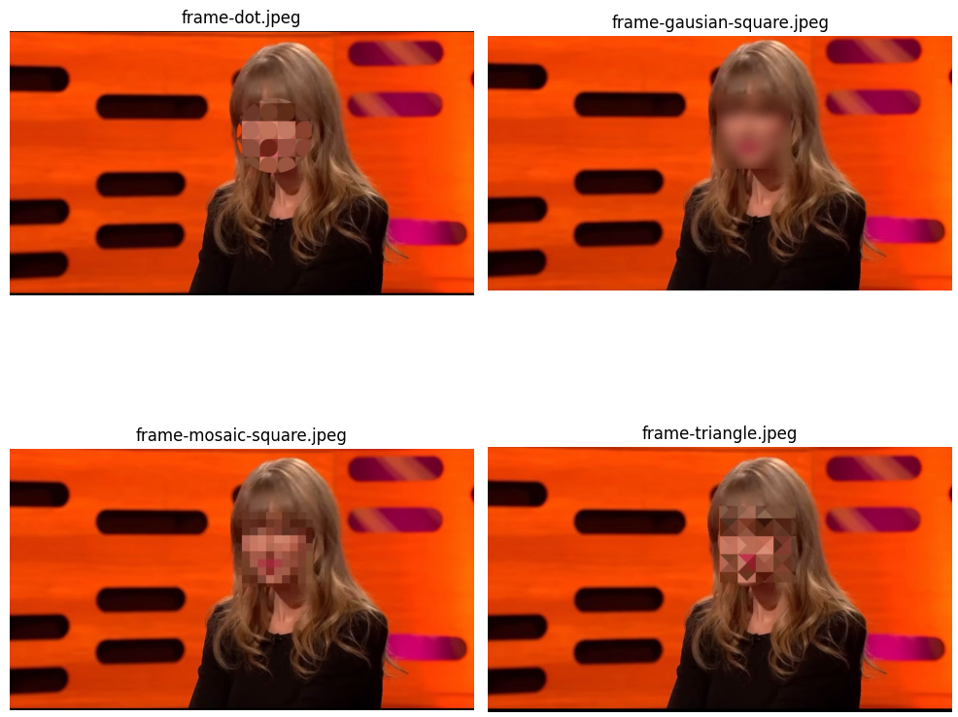
Sample Results

Slide 18
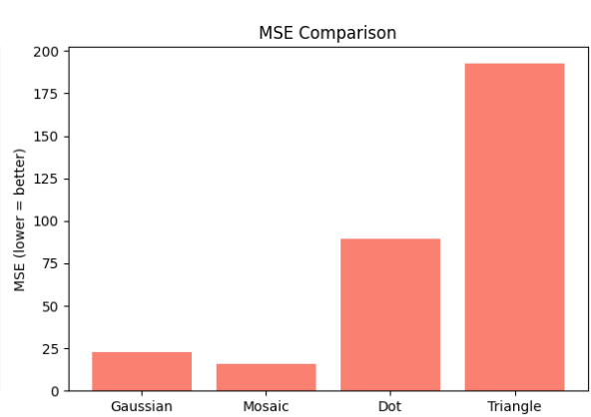
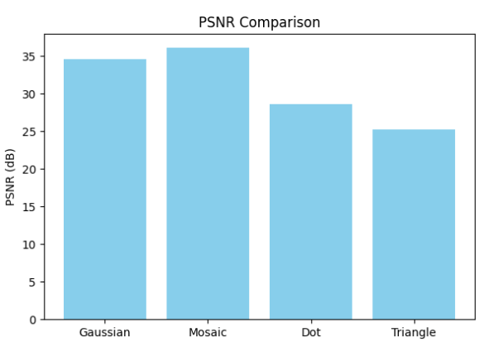
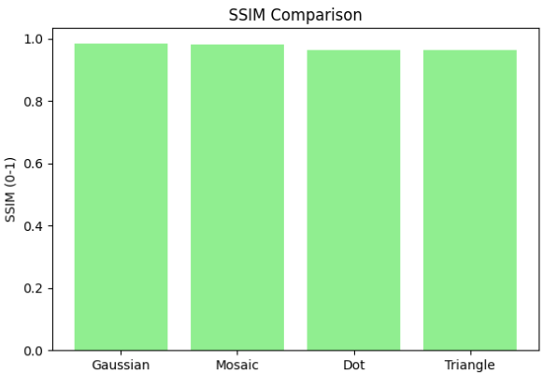
Evaluation
PSNR (Peak Signal-to-Noise Ratio) measures the quality of the blurred image compared to the original; higher PSNR indicates better visual quality.
SSIM (Structural Similarity Index) assesses the perceptual similarity between two images; higher SSIM (closer to 1) means better structural preservation.
MSE (Mean Squared Error) calculates the average squared difference between the original and blurred image; lower MSE is ideal as it indicates less distortion.

Slide 19
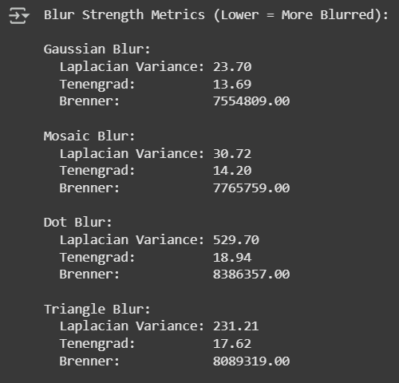
Evaluation
Laplacian Variance measures the sharpness in an image; lower values indicate more blur.
Tenengrad is a gradient-based sharpness measure; lower values mean the image is more blurred.
Brenner is another focus measure based on pixel differences; again, lower values signify greater blurring.

Slide 20
RESULTS
Gaussian Blur shows the lowest values across all blur strength metrics, making it the most effective at anonymizing the face.It provides a balanced performance between maximum anonymization and minimal quality loss.
Dot Blur is the least blurred and therefore least suitable for anonymization.
Triangle Blur and Mosaic Blur offer moderate levels of blur — acceptable, but not as strong as Gaussian.
Mosaic Blur slightly outperforms in PSNR and MSE, indicating good visual quality retention.
Triangle Blur has the worst MSE, meaning more distortion.
Dot Blur, despite decent SSIM, lacks in blur strength and introduces more error.
Best for anonymization: Gaussian Blur — strongest blur with good visual quality.
Best visual quality retention: Mosaic Blur — strong PSNR and SSIM, moderately blurred.
Not ideal: Dot Blur (least blurred) and Triangle Blur (high distortion).

Slide 21
Thankyou

